Slide 1
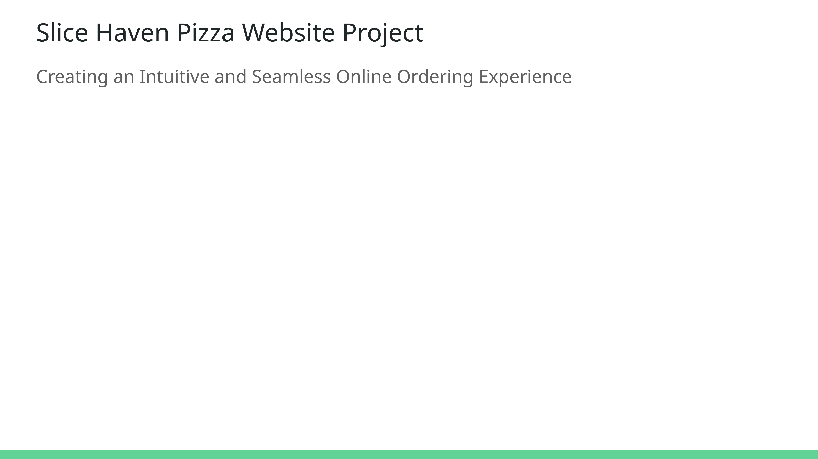
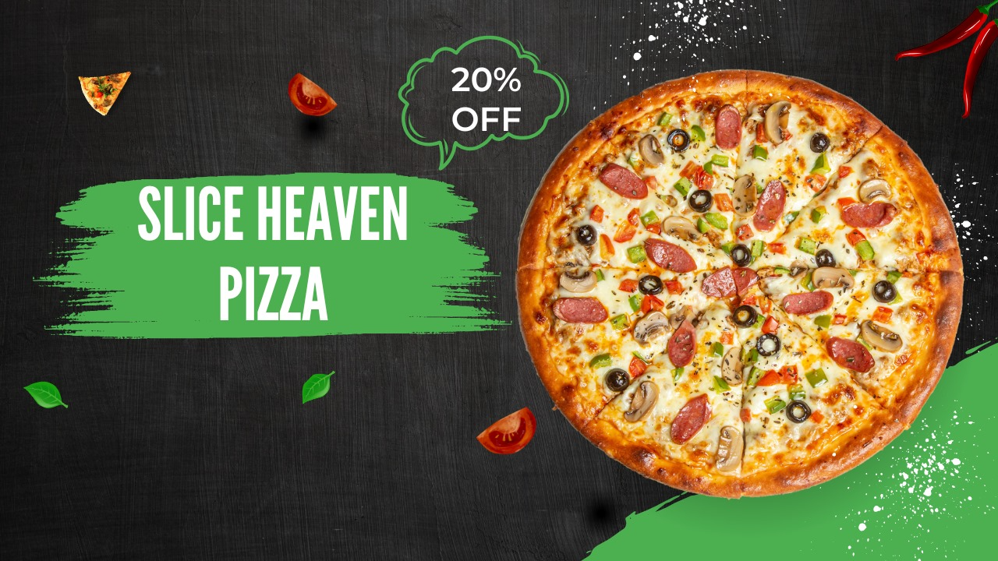
Team 1
Monika Gundecha
Nikhil Doye
Vanshil Vadi
Notes:
Welcome to the presentation on the Slice Haven Pizza Website Project. This full-stack application was designed to create an intuitive and seamless online ordering experience for pizza lovers. By leveraging a pizza-themed design with warm tones, we aimed to reflect the inviting and flavorful experience that Slice Haven embodies.

Slide 2
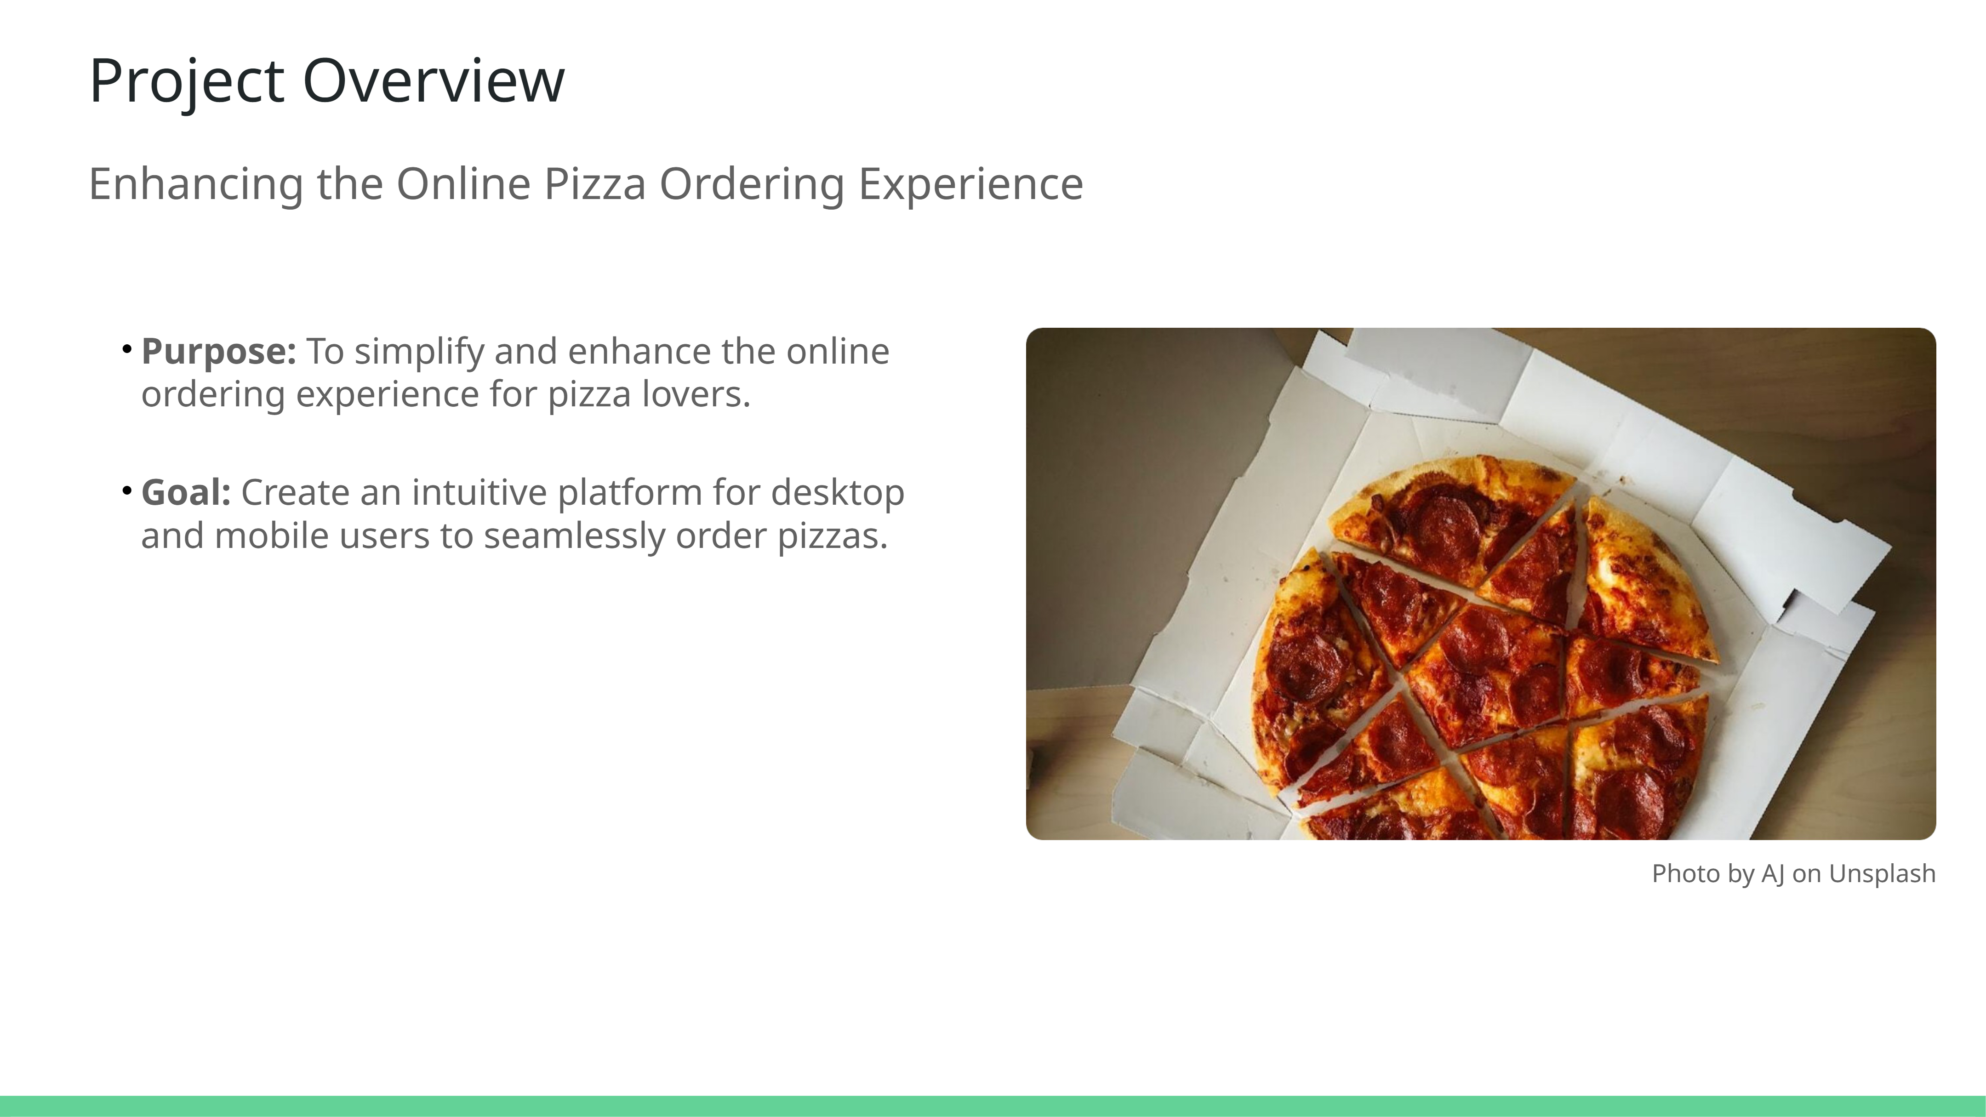
Notes:
This slide introduces the project's purpose and goals. The Slice Haven Pizza Website aims to simplify the ordering process, catering to pizza enthusiasts seeking convenience. Our primary objective was to design a user-friendly platform adaptable for both desktop and mobile users. By leveraging modern web technologies, we ensured a seamless and enjoyable user experience, emphasizing ease of navigation and vibrant design.

Slide 3
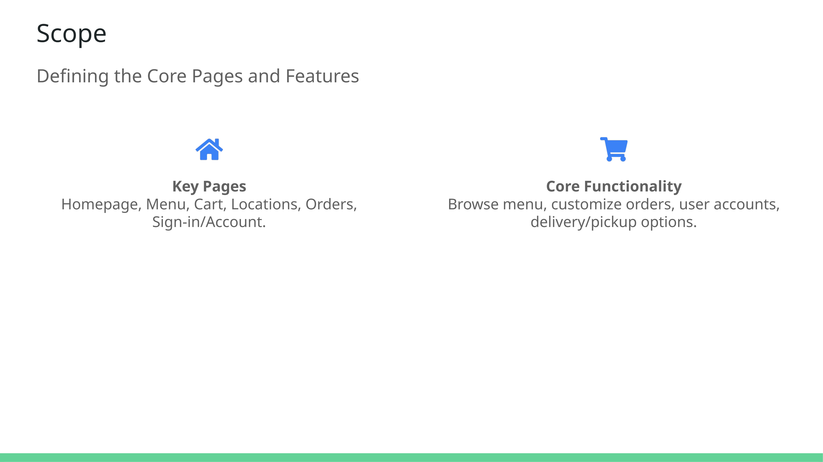
Notes:
This slide outlines the project scope by detailing the key pages and functionalities of the Slice Haven Pizza Website. It includes essential components such as the homepage, menu, cart, locations, orders, and sign-in/account pages. The functionalities like browsing menus, customizing orders, creating accounts, and choosing delivery or pickup options were critical for a seamless user experience.

Slide 4
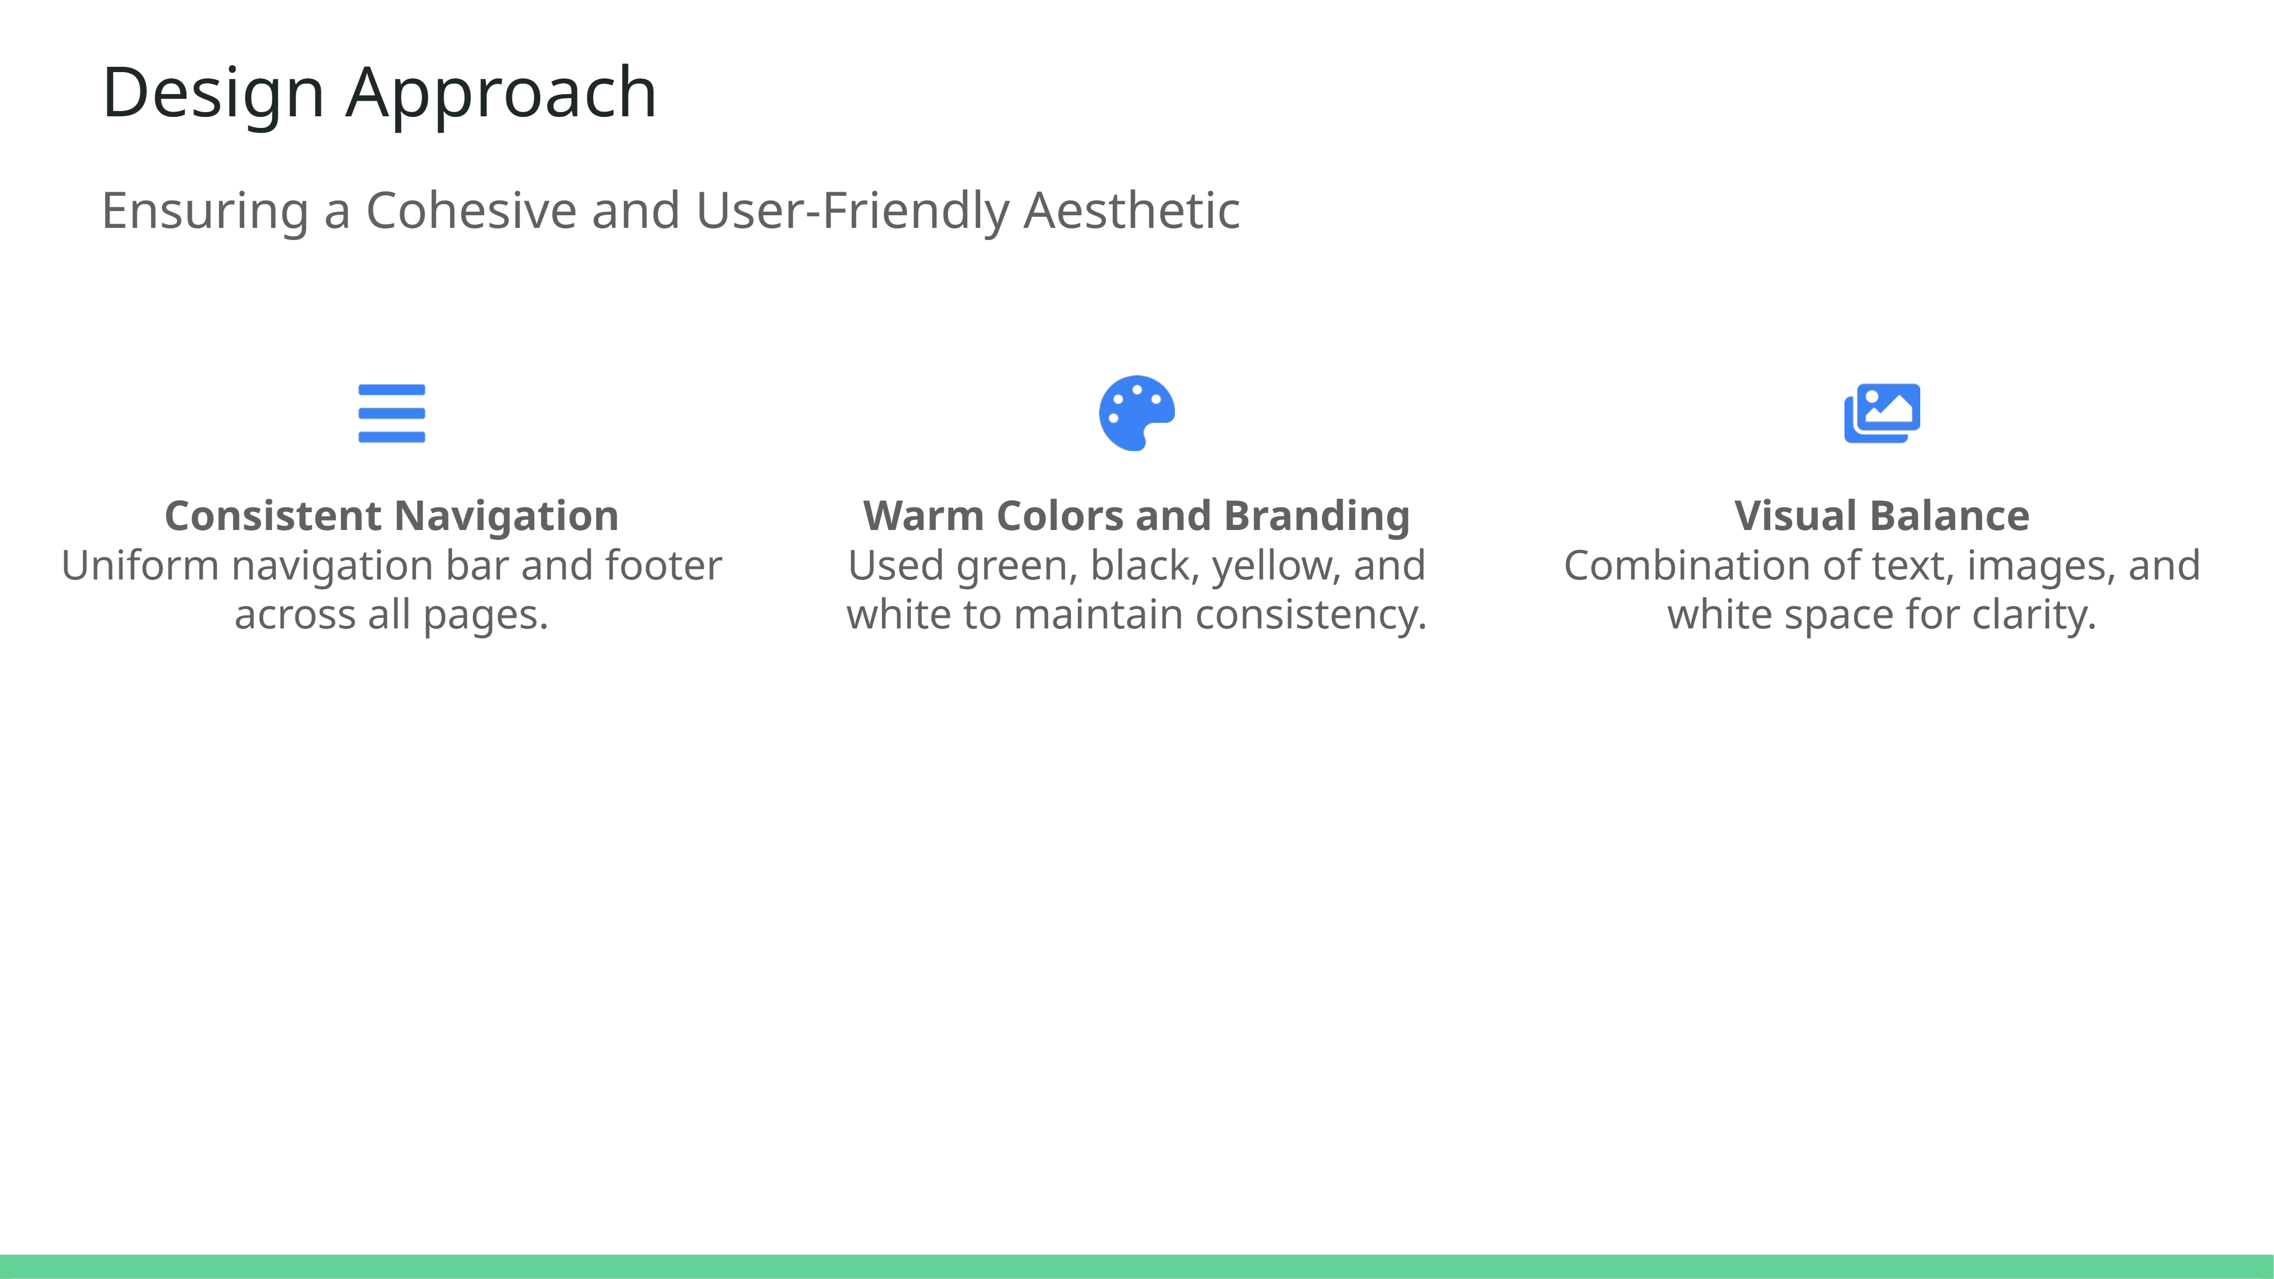
Notes:
In designing the Slice Haven website, we focused on a cohesive aesthetic that reflects its brand identity. A consistent navigation bar and footer enhance usability, ensuring a seamless transition across pages. The color palette aligns with the vibrant, warm tones of the website's theme—green, black, yellow, and white—fostering a visually pleasing experience. Additionally, a balanced mix of images, text, and white space was employed to keep the design user-friendly and accessible.

Slide 5
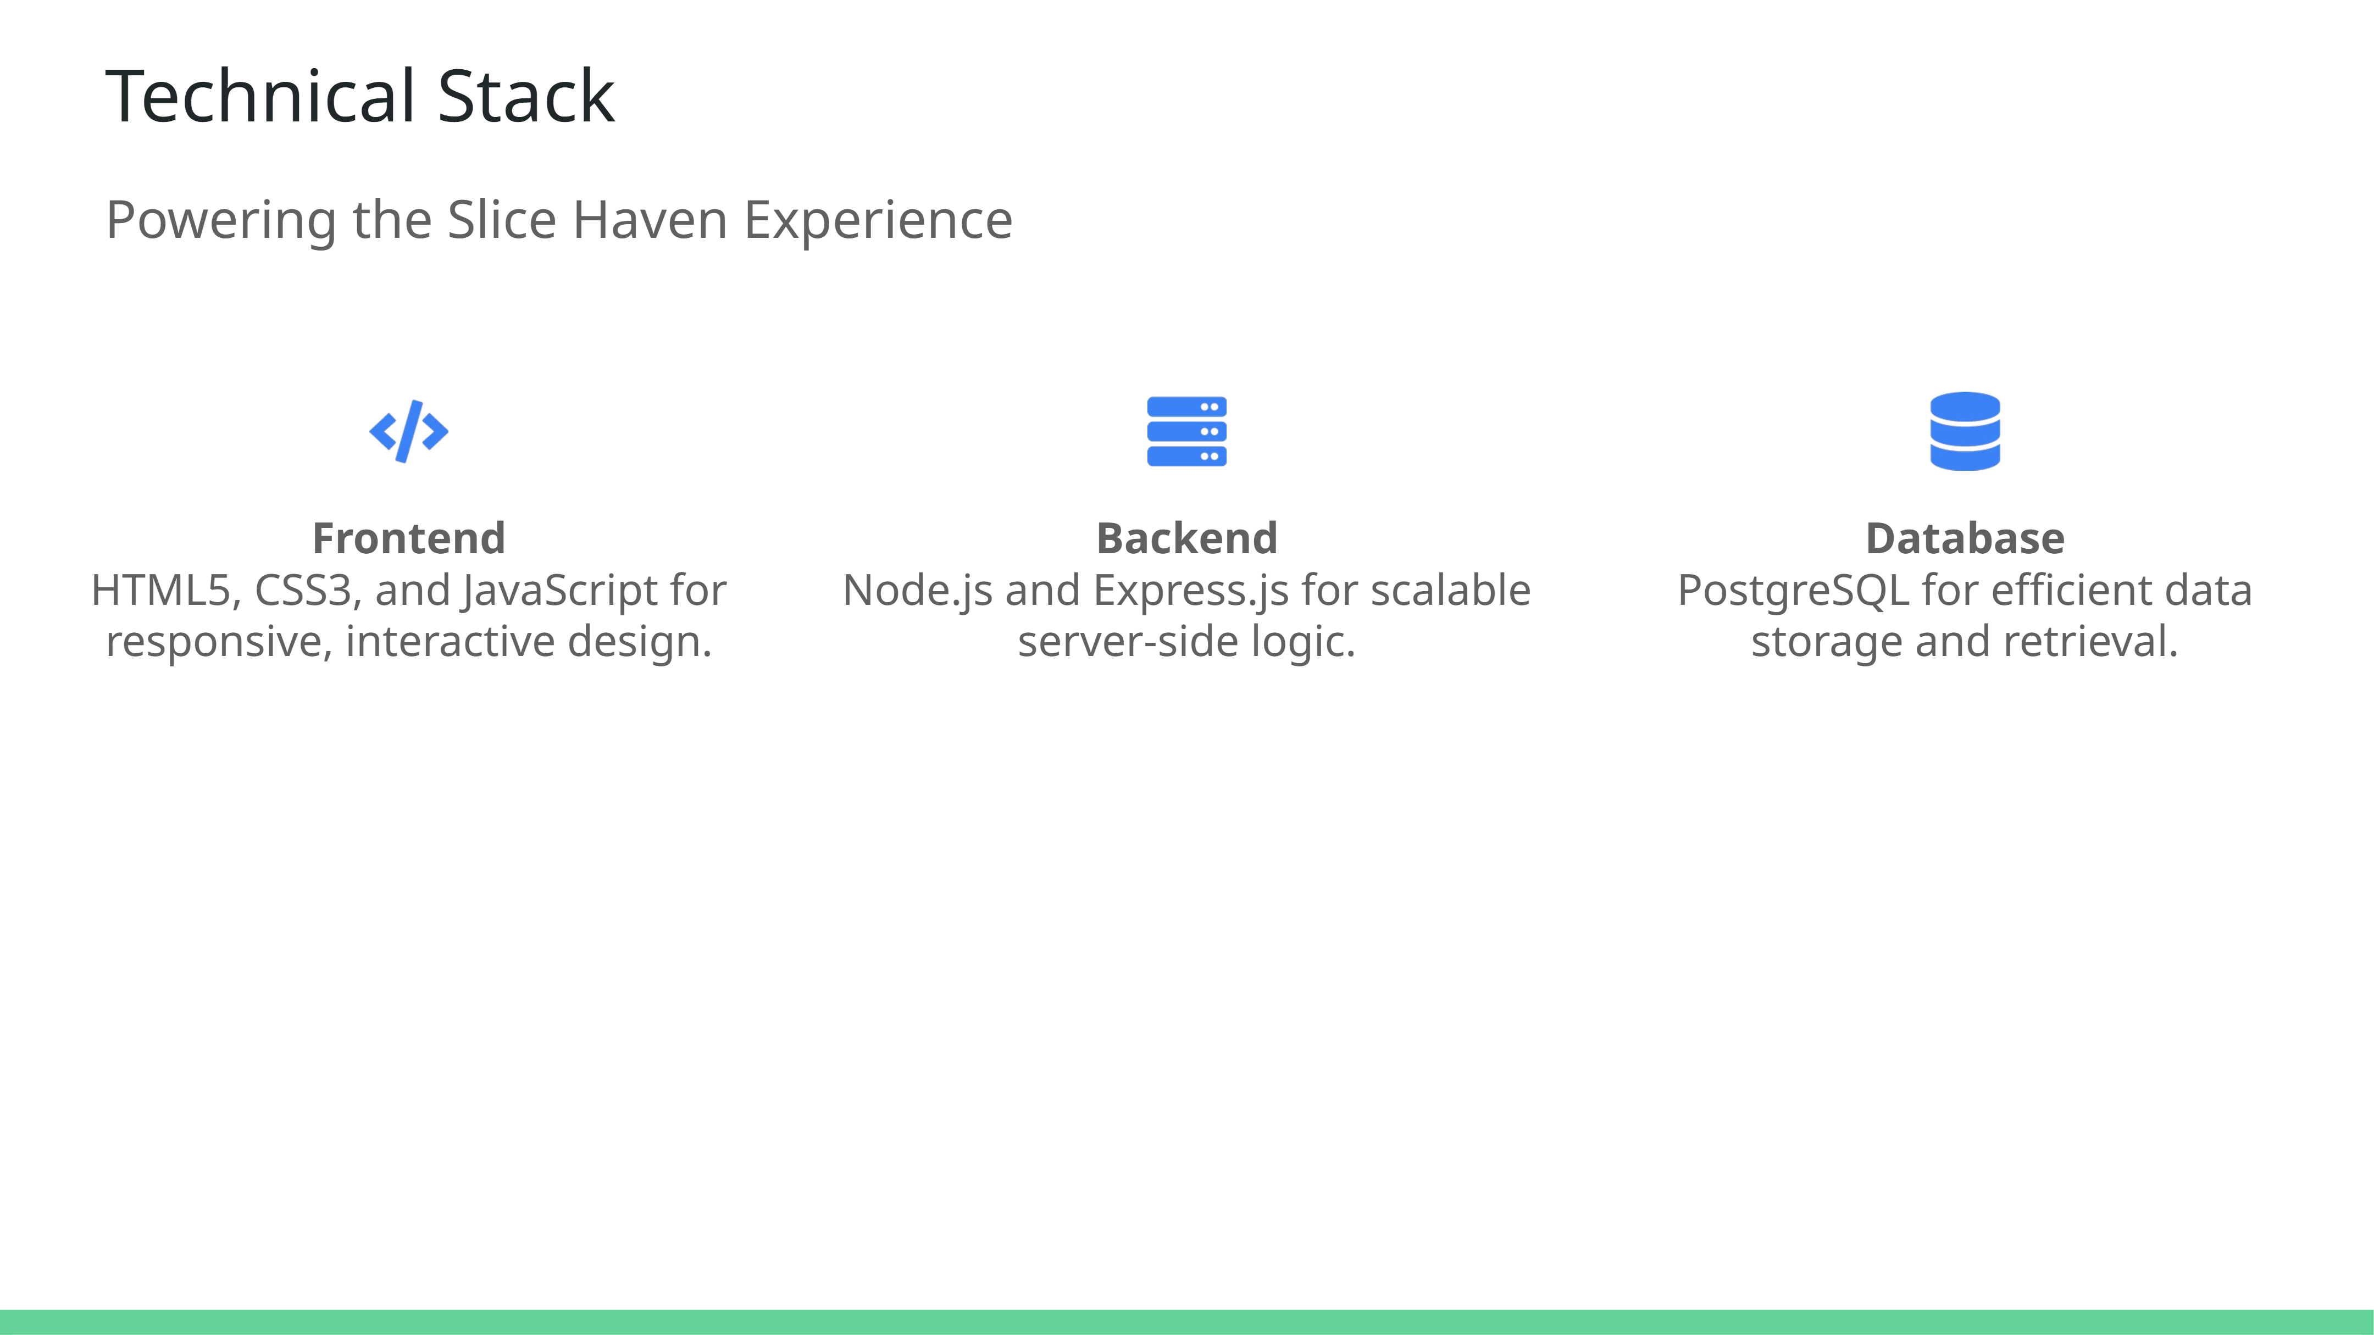
Notes:
The Slice Haven Pizza Website employs a modern technical stack to ensure performance and scalability. On the frontend, HTML5, CSS3, and JavaScript deliver a responsive and engaging user interface. Backend operations are managed with Node.js and Express.js, offering robust and scalable server-side logic. Finally, PostgreSQL serves as the database solution, enabling efficient data storage and fast retrieval to enhance the user experience.

Slide 6
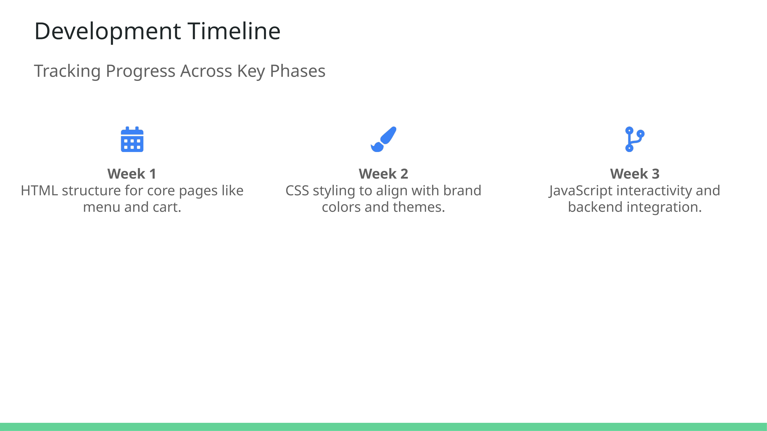
Notes:
This slide captures the phased development approach for the Slice Haven Pizza Website. Week 1 focused on establishing a solid foundation with HTML structures for essential pages such as the menu and cart. In Week 2, CSS was applied to ensure that the design reflected the brand’s theme. By Week 3, JavaScript was introduced to enhance interactivity, and backend integration brought functionality like dynamic loading and secure authentication.

Slide 7
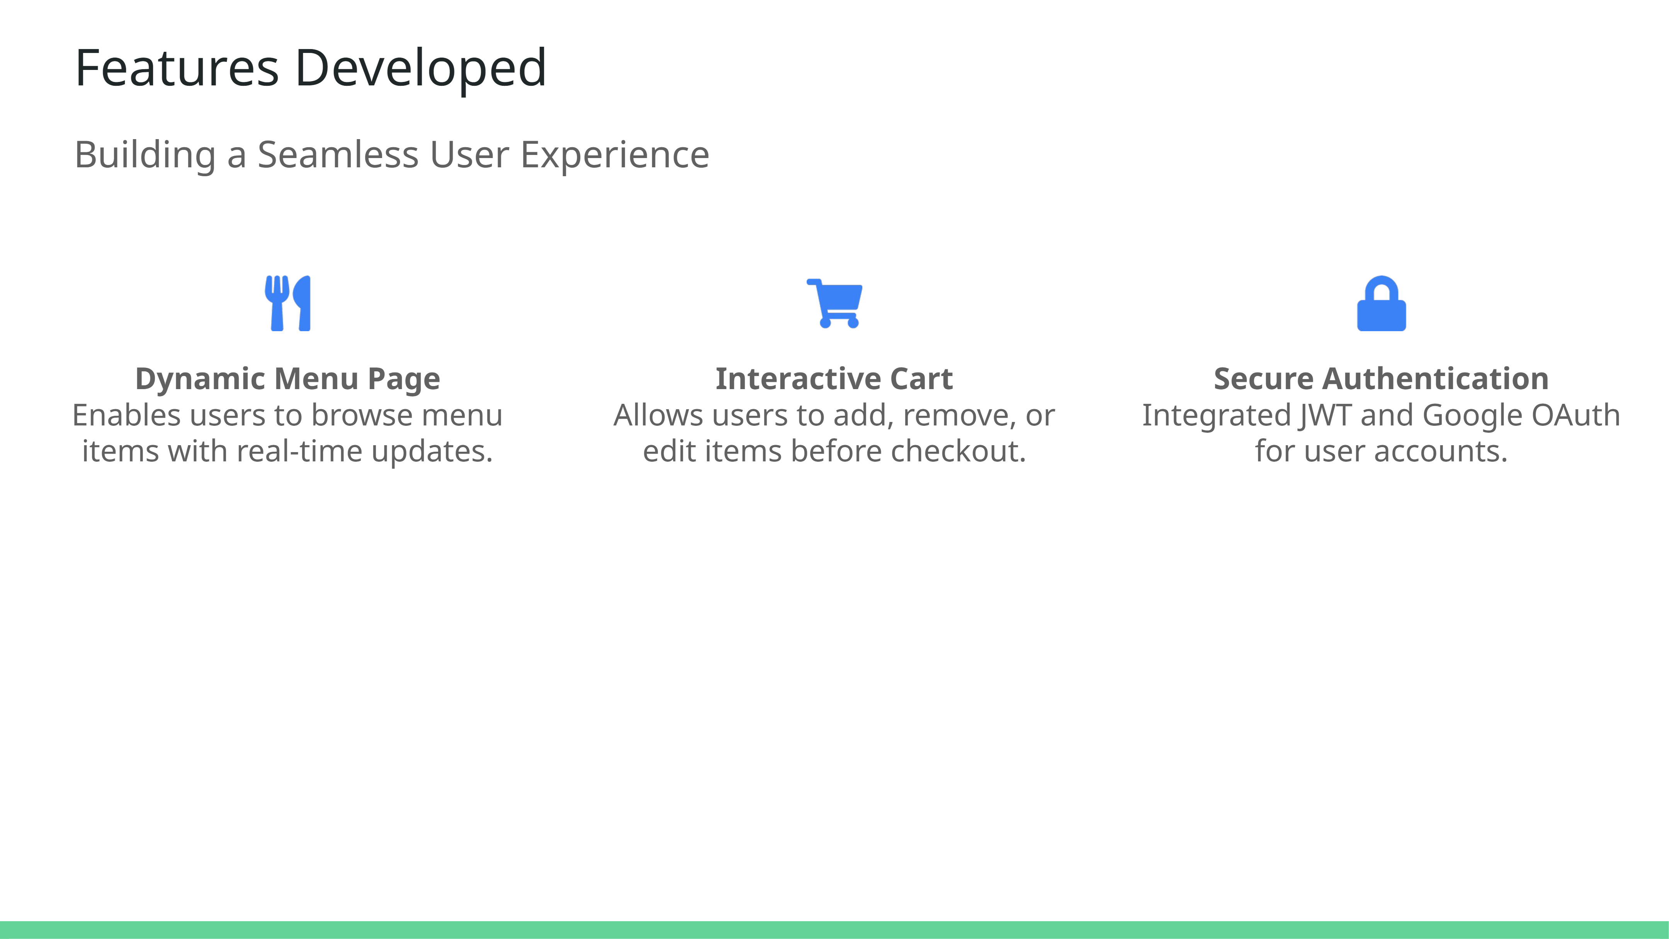
Notes:
This slide highlights the key features developed for the Slice Haven Pizza Website. The dynamic menu allows users to browse and update selections in real-time, creating a seamless browsing experience. The interactive cart provides flexibility, letting users manage their orders with ease before finalizing. Lastly, secure authentication using JWT and Google OAuth ensures user data is protected while offering a smooth sign-in process.

Slide 8
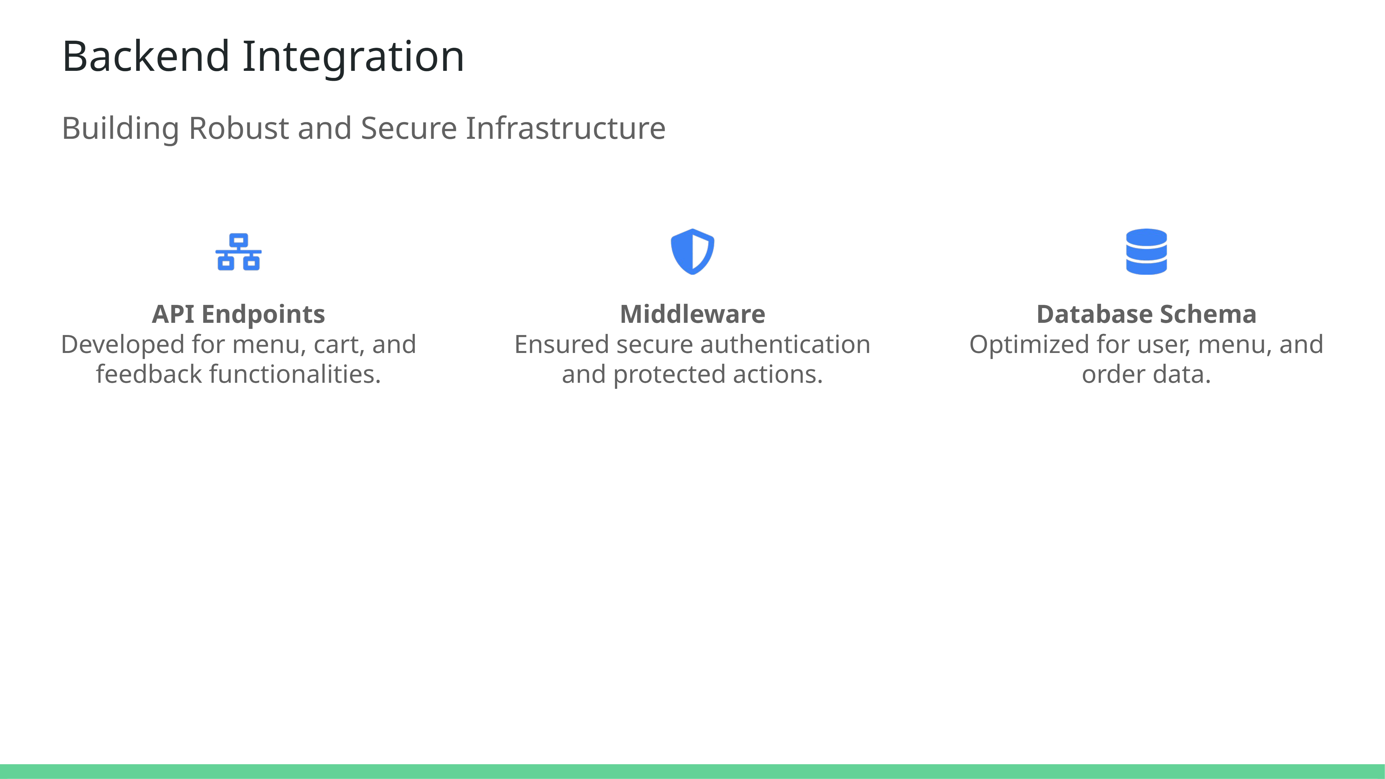
Notes:
The backend of the Slice Haven Pizza Website integrates secure and robust infrastructure. API endpoints power dynamic features such as menu browsing, cart updates, and feedback submissions. Middleware enhances security, enabling protected actions like user authentication and order processing. The database schema was designed to efficiently handle key data entities, ensuring scalability and performance as the application grows.

Slide 9
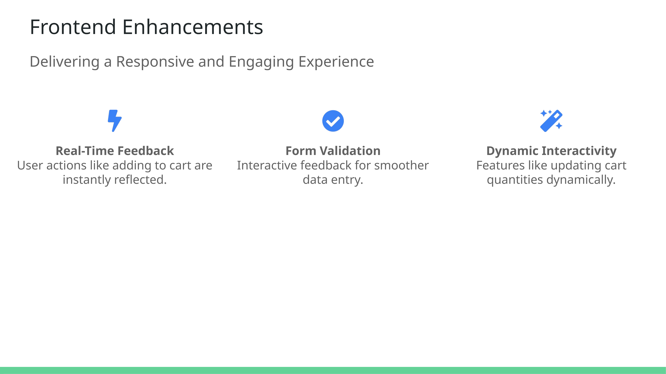
Notes:
Frontend enhancements ensure an engaging user experience for Slice Haven. Real-time feedback allows users to see the immediate effect of their actions, such as adding items to their cart. Form validation provides interactive guidance, minimizing user errors during data entry. Dynamic interactivity features, like updating cart quantities seamlessly, further elevate the user experience, making the process intuitive and efficient.

Slide 10
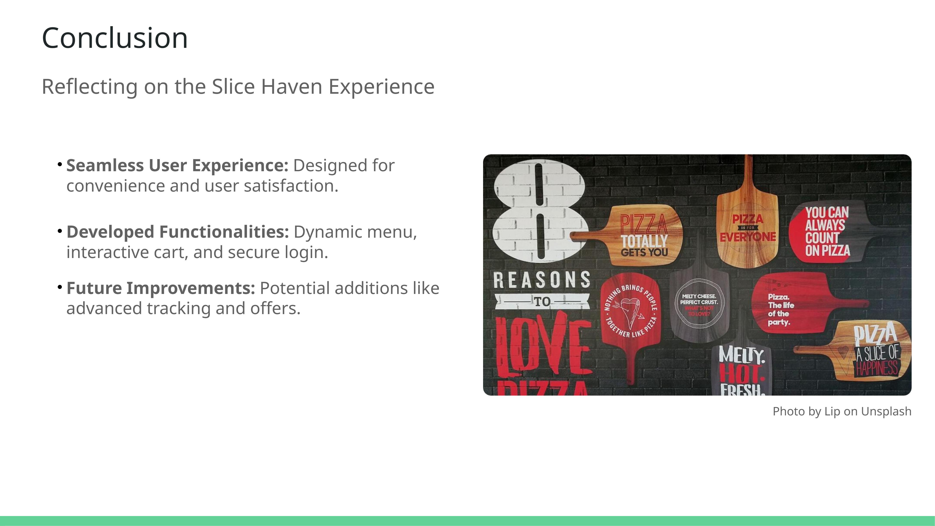
Notes:
In conclusion, the Slice Haven Pizza Website was built with a focus on enhancing the user's online ordering experience. From a seamless interface to robust backend features, it delivers both convenience and functionality. The dynamic menu, interactive cart, and secure login set a solid foundation for its usability. Looking ahead, future improvements, such as advanced tracking and personalized offers, can further elevate the user experience. Thank you for your attention!

